Slide 1
2023 Nepal Tobacco Industry
Interference Index
Shanta Lall Mulmi
National Coordinator
Health Rights and Tobacco Control Network
September 2023

Slide 2
Overview
Background
A Global initiative taken by GGTC and SEATCA
HRTC is preparing this report since 2019
Report has been prepared with Desk Study, Field Study, Media Report and Personal Interview.

Slide 3
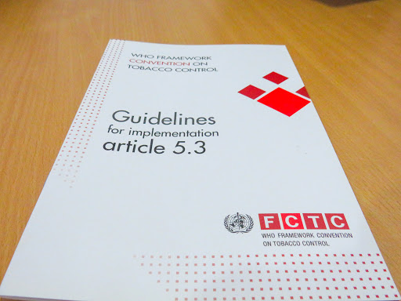
WHO FCTC Article 5.3
“In setting and implementing their public health policies with respect to tobacco control, Parties shall act to protect these policies from commercial and other vested interests of the tobacco industry in accordance with national law.”
2008 Article 5.3 Guidelines

Slide 4
Indicator 1:
The industry's participation in policy development
There is no evidence to show the involvement of tobacco Industry representation in health policy development and also tax policy formulation.
There is a practice of inviting different industry and commerce association / federations
In the coming budget the tobacco tax could be progressively increased by 60% making the target to meet the tobacco Tax as per India. If the government increases tobacco tax more than 35% the government can generate additional revenue of 63 to 75 billion and the tobacco consumption will be reduced by 3-7%.

Slide 5
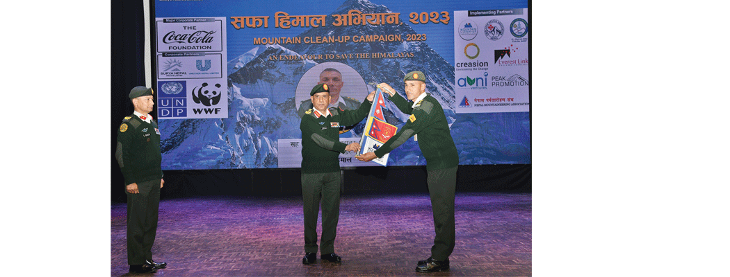
Indicator 2:
Tobacco Industry CSR is banned
The Government not legally allowed to receive any financial sponsorship or support from the tobacco industry through its CSR activities.
But Surya Nepal conducts CSR activities in 4 categories: “Asha” focusing on community empowerment; “Khelpartyatan” on sponsorship of sports and tourism activities; “Suswasthya” on health-related activities; “Prakriti” on environmental preservation: greenery and tree planting projects
In February 2023, the Brigadier General of the Nepali Army signed a tripartite agreement with the Managing Director of Surya Nepal and Centre for Research and Sustainable Development (CRSSD) towards the Mountain Cleanup Campaign of Mt Everest

Slide 6
Indicator 3:
Benefits given to the tobacco industry
The WHO FCTC recommends all parties to raise tobacco tax by at least 75% of the retail price.
Nepal raised the cumulative tax by only around 40%. This is an indication of tobacco industry interference in government's effort in raising tobacco tax.

Slide 7
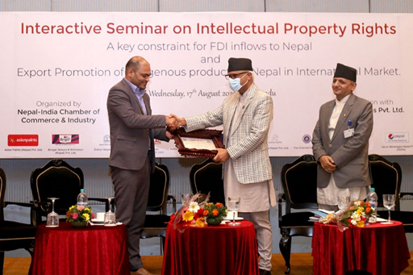
Indicator 4:
Unnecessary interaction between government & industry
The tobacco market in Nepal is controlled by private sector productions after the collapse of state-owned Janakpur Cigarette Factory
The Nepal Rastra Bank study listed 23 type of smoking and 21 smokeless tobacco products available in Nepali Market.
Surya Nepal is a large business worth Rs 24.5 billion in 2022
Every year Surya Nepal is awarded
as the highest tax payer company
and is honored by the government.

Slide 8
Indicator 4:
Unnecessary interaction between government & industry
There are 30 registered tobacco companies in Nepal but Surya Nepal holds about 70 to 75% of the cigarette market share, whereas Gorkha Lahari pvt ltd holds 20% of the market share. There are numerous unregistered bidi and chewing tobacco manufacturing companies .
Nepal Health Research Council came with the conclusion that 15% of the school going children use tobacco products. And out of 9 million Tobacco users more than 1 million are suffering from chronic diseases. In addition, about 34% of the low-income adults spend major part of their income for tobacco making them venerable to more economic burden.
The death of more than 27,000 Nepalese due to Tobacco related disease indicates that Nepal cannot reach the SDG target in the remaining 7 years
The government has recently formulated Multi Sectoral Action Plan as control of NCD (2021-2025) with a vision of ''Making Non-Communicable Disease-free Health and Productive Citizen''.

Slide 9
Indicator 5:
Measures for transparency
There is no system of disclosing any meeting with the tobacco industry nor is there any transparency in the meeting minutes made available to the public.
Tobacco company is not required to provide any data (reporting) to the concerned ministers about their total production, sales, market coverage, marketing expenses, lobbying, political contributions

Slide 10
Indicator 6:
Preventing conflicts of interest
There is no formal record of contributions made by TI in the last local, provincial and federal Parliament election.
Lack of Information from Leading Political Parties on their income sources for the election/

Slide 11
Indicator 7:
Measures that prevent industry influence
No records of meeting minute are written and there is not any information on formal meeting with TI.
As per Tobacco Product Control and Regulation (Article 5, Rule 48), government officials cannot accept any gifts from the tobacco industry. The Regulation states that any nominated member of the Committee “found to be involved directly or indirectly in the manufacture, import, export or sales and marketing of tobacco products” may be removed from his or her post.

Slide 12
Indicator 7:
Measures that prevent industry influence
National Health Education, Information and Communication Centre (NHEICC) of the Ministry of Health and Population, being the focal agency of WHO FCTC implementation regularly organize training/ workshops to the concerned government offices. Modality and frequency of these program is not available.
There is no record of accepting any contribution /gifts from tobacco Industry in this reporting period (2021- March 2023)

Slide 13
Recommendations
Increase Tobacco Tax to Make Tobacco Products Less Affordable:
  Nepal still has minimum tax on tobacco products. Hence there is a need for the government to increase tobacco tax as per WHO FCTC requirement.
Terminate CSR Partnership with Nepal Surya on Mountain Clean Up:
  The law does not allow government departments to receive funds/sponsorship from the tobacco industry. This law should be implemented.
Tobacco company must not be awarded for paying taxes:
  A tobacco company should follow the law and pay the taxes that are due. The government should not award a company just for complying with the law.

Slide 14
Recommendations
Improve Transparency Measures:
  The Constitution of Nepal in Article 17 on Right to Information says that Every citizen shall have the right to demand and receive information on any matter of his or her or of public interest: On the basis of this legal provision, there is no information provided by the government on the meetings/dialogue with the tobacco Industry.
Empower Civil Society as Change Makers:
  Article 4.7 of the WHO FCTC refers to civil society’s essential role in implementing the treaty.
Ensure Tobacco Industry Complies with Tobacco Products and Control and Regulation Law:
  The government should implement the law to ensure Surya Nepal abides by the Tobacco Products Control and Regulation Law. The Ministry of Health and Population should step up their efforts to raise awareness on the requirements of WHO FCTC Article 5.3 not to form any partnerships with the tobacco industry by the government.

Slide 15
Tobacco Industry Interference: Country Ranking
Study Made in the total of 80 countries.
9 countries including UK, France, Netherland, New Zealand ranked best countries with 15 to 39 score.
15 Countries including Nepal, Thailand, SriLanka, Pakistan comes to second best with 40-49 score
57 country including India, Myanmar, Ghana ranked third category with 50-59 Score.
13 countries including Malaysia, Ukraine, Germany South Africa scored 60-80 Points.
15 countries including Bangladesh, China, USA, Italy comes with 70-79 scores.
5 Countries including Japan, Indonesia, Switzerland have maximum Level of Industry Interference.

Slide 16
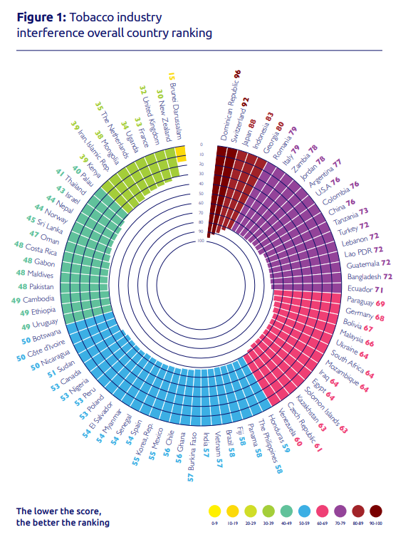

Slide 17
Thank you!
for more information, visit
www.globaltobaccoindex.org

